Slide 1
DevOps in a highly regulated environment
DevOps Enterprise Summit
London, 29 June 2016
Robert Scherrer, Head Application Engineering

Slide 2
About SIX out of an IT perspective
DevOps @ SIX
The audit logic
Specific requirements and how to handle them

Slide 3

Trading
2000 times faster than the blink of an eye
Notes:
We are Swiss Exchange and provide ultra low latency in trading, 35 micro seconds from trader to the matcher and back to the trader.
So our speciality is low latency, but that is not all…

Slide 4

Post Trading
the stronghold for securities
Notes:
We are the Swiss CSD, storing values of all kinds, physically as well as electronically, security and data consistency is crucial
We also process the Swiss Franc system for Swiss National Bank. So if you read about Swiss National Bank increasing liquidity to stabilize Forex markets, it is our IT transferring these Billions.
So another specialty is secure transactions, but there is more…

Slide 5

Financial Information
7’000’000’000 price updates per day
Notes:
We provide information from hundreds of stock exchanges, which results in a message throughput you can compare to the flapping of wings in a swarm of birds
Our systems have to provide maximum throughput and it grows faster than Moor’s Law
An there is more…

Slide 6

Payment Processing
99.998% application up-time
the IT that never sleeps
Notes:
We process payments around the clock with highest business availability while having ultimate data consistency.
(we can not simply be available, we have to process every payment once and exactly once)
→ Our Systems have to be able to alter the database structure while providing data consistency and being online, if you already tried this, you can imagine the difficulties.

Slide 7
SIX - For a stable and efficient financial market infrastructure
1930 the company was founded to provide a stock exchange ticker.
4000 people
working for SIX in 36 locations in 25 countries.
160 billion francs flow backwards and forwards in interbank payments each day.
20 million
financial instruments are covered in the SIX data universe.
3,100 billion
francs is the amount SIX currently manages as central securities depository for Swiss securities.
700 engineers and operators
are providing the software applications to run the business of SIX.

Slide 8
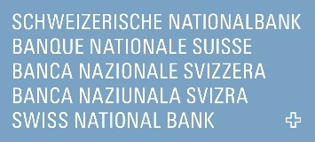



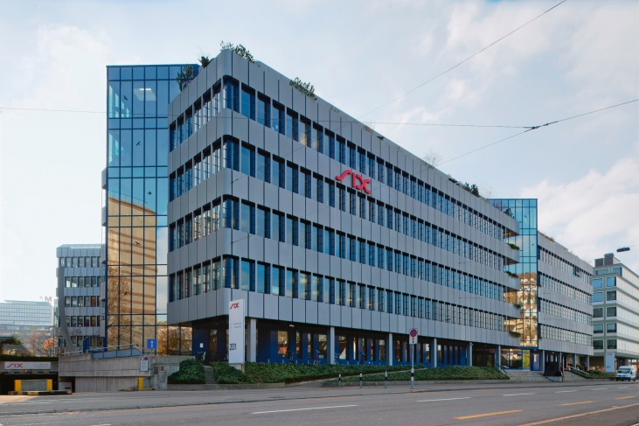


SIX is affected by multiple regulators and standards
Notes:
While we are providing all these specialities with our IT, we are regulated by various regulators and standards organizations and are affected by the growing requirements.

Slide 9
About SIX out of an IT perspective
DevOps @ SIX
The audit logic
Specific requirements and how to handle them
Notes:
So why do we want to do DevOps.
As our business guys are very happy with our stability and reliability, there is room for improvement in time-to-market.
We are convinced that we have to be faster in launching new functionality and that DevOps is the right way.

Slide 10
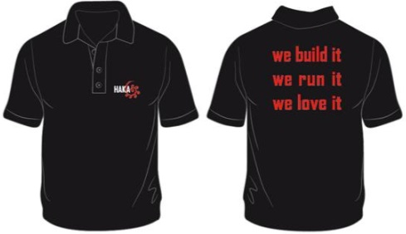

2015, we started a DevOps movement
we created a vision
we defined our principles
We collaborate in cross functional teams and help each other to improve
Teams take ownership for their products over the whole lifecycle
We automate repetitive tasks wherever possible
We have working software on every stage any time, incl. monitoring
We do software-architecture
We use one repository
We won't stop until we don't do anything anymore that we don't have to
We inspire and motivate our colleagues
We employ scalable infrastructure
We love to deliver yesterday what impresses our customers tomorrow.
we wear our shirts
we started a movement to convert all 700 engineers and operators into a DevOps organization.
It’s all about mindset and attitude!
Notes:
In 2015, we started our DevOps movement.
From the first day on, we focused on inspiring people and not on tools or technologies because we are convinced that it is the mindset that is most crucial to achieve a true DevOps organization.
We started with a small core team of a dozen key players and created our vision, defined our principles and of course we wear our shirts.
And since then, we scaled up by inspiring larger and larger communities of employees.
And of course, we also invest in automation and a scalable infrastructure.

Slide 11

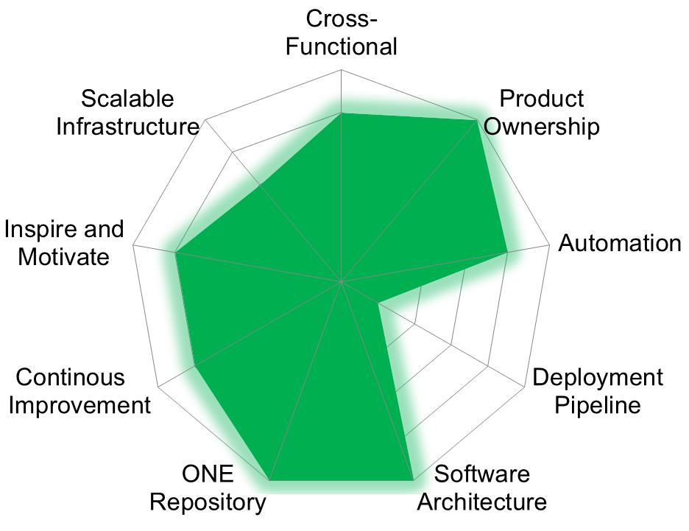

We came quite far until now!
Sample team KPIs:
65% of development teams “wear pagers”
28% organized already in truly x-functional DevOps teams
first container-based continuous deployment
first pioneer value streams extended to include business representatives
Readiness Check for Team …
Principle Value
Cross-Functional 4 The Operators / Developers collaborate closely and are in the same team
Product Ownership 5 We know from our customers that the product is successful. He/She gives feedback to us
Automation 4 Still some repetitive manual work for the hard parts.
Deployment Pipeline 1 Build what?
Software Architecture 5 Is part of our daily work.
ONE Repository 5 Code and configuration is in one single repository
Continous Improvement 4 We improve continuously and eliminate waste
Inspire and Motivate 4 We are in contact with other teams and help and inspire each other
Scalable Infrastructure 3 We can deploy parts/components of the system separately
Now this is not the end. It is not even the beginning of the end. But it is, perhaps, the end of the beginning
Winston Churchill
Notes:
Our original expectation to have 10% of the organization transformed until end of 2016.
And not even a year after the start, we have already made progress way beyond this goal.
On the right hand side, you can see how we measure teams in a way to show, where there is the greatest need for improvement and raise the ambition of the teams to improve.
With all this progress, we see ourselves on the beginning of a long journey of continuous improvement.
Or, beeing in good old England, as Winston Churchill would say: …

Slide 12
About SIX out of an IT perspective
DevOps @ SIX
The audit logic
Specific requirements and how to handle them
Notes:
Now, I come to the main topic of my speech, which is:
Bringing DevOps and regulatory compliance together.
Let’s start with the logic of an audit:

Slide 13



Two-tier vs. three-tier
Directive covers requirement?
Regulatory
requirement
Product fulfills requirement?
Regulatory
requirement
Internal directive
Product complies to directive?
Product
Prefer fulfilling requirements directly
Product
Notes:
The simple case is that you get a requirement you have to fulfill and the auditor looks for evidence that you really do. This is quite straight forward.
Very often, the original requirements are covered by an internal directive and you have to follow the directive.
So the auditor checks whether the directive covers the requirements and whether our system complies to the directive.
I definitely prefer fulfilling the original requirements. Why is this so important?

Slide 14

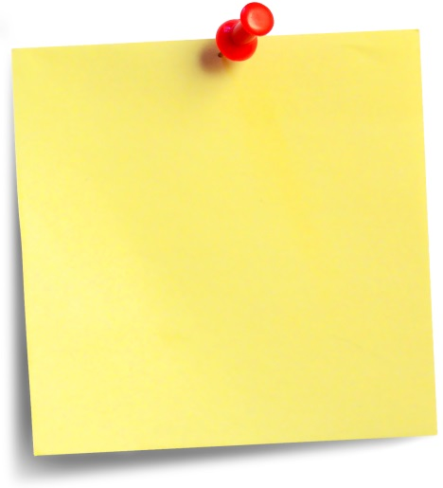
We all like adding value – so do compliance officers!
original requirement:
4 Password generations
internal directive:
20 Password generations
Always look for the original requirement
Notes:
The first challenge with internal directives is that they usually go beyond the regulatory requirements.
It is somehow in the nature of good employees to improve the things they do.
Only if they improve here, it gets much harder to stay compliant.

Slide 15
Adding up requirements makes it worse
Regulator A
requirement
Regulator B
requirement
Regulator C
requirement
internal directive
covering all requirements
Product A
Product B
Product C
Notes:
As we are an multinational provider of financial services, we have multiple regulators.
Each regulator has its own requirements and the affected IT solutions have to be compliant.
Now, if you have directives that cover all requirements out of one place, the individual requirements sum up.
This makes achieving compliance hard, because and you have to cover all requirements in all products.

Slide 16
IaaS and PaaS do not help
Regulator A
requirement
Regulator B
requirement
Regulator C
requirement
Plan separate infrastructure pools per regulator
Product A
Product B
Product C
shared infrastructure
Notes:
Here, a first DevOps aspect comes in.
If you share the runtime platform, you risk a spillover from one software to the other. In an ideal world, the auditor accepts the underlying technology as a full grown isolation.
Out of my experience, it is difficult to impossible to convince regulators in this matter. While older technologies like LPARs on IBM z-Series are usually seen as mature enough, this is not the case for the upcoming platforms like Openshift or Cloud Foundry.
So it is much easier to separate infrastructure pools than to implement measures to improve the isolation within one infrastructure pool.
This is already an area where we do not simply fulfill requirements but work together with the auditor towards an acceptable solution…

Slide 17
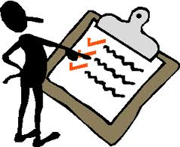

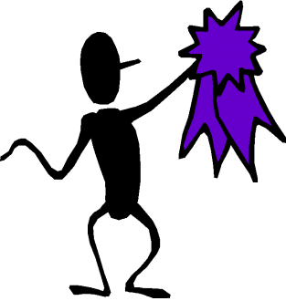



It is always a negotiation with the auditor
Involve the auditor at an early stage and agree on the interpretation of the requirements
involve early
find agreement
Notes:
Especially with DevOps, we are leading edge in processes, tools and infrastructure.
The best way is to involve the corresponding auditor as early as possible.
We discuss our plans to change things before we even start implementing. And for sure long before the next audit is scheduled. This gives the regulator the opportunity to take part in our thoughts and to influence the solution.

Slide 18
About SIX out of an IT perspective
DevOps @ SIX
The audit logic
Specific requirements and how to handle them

Slide 19
Segregation of duties (1/3) Developer access to production systems allowed?
SIX Group Directive no. 5.2, Appendix 8, 1.5.1
---
… In particular, there must be a separation in terms of the personnel performing the roles for infrastructure operations and administration …
Reverse engineer, where the requirement might come from
external requirement *
or
internal wish
Amend the directive
* e.g. PCI DSS #6.4.2 only requires a separate role
Notes:
I start with “segregation of duties”, maybe the most popular topic.
In traditional functional silos, developers and operators are separated and production access is a task for operators.
With x-functional teams, this changes dramatically.
When I look at where segregation of duties comes from in our company, it comes from an internal directive.
So what can I do? Well, try to find out whether this is explicitly coming from one of our regulators or not.
In our case, we haven’t found a source till today. To be very honest, we haven’t stopped searching at this point in time.
The next step will be to amend the directive or to negotiate a special interpretation for DevOps teams.
What helps in the negotiation is that DevOps brings massive improvements.

Slide 20
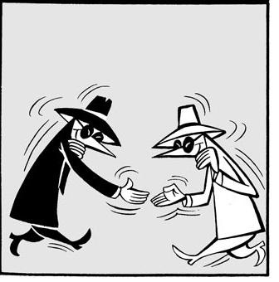




Segregation of duties (2/3) Release automation improves auditability
fully automated transparent process
immutable servers
manual hand-over
manual installation
server patching
Notes:
Replacing manual interactions, even if they have been done by separate individuals, is an improvement to transparency, traceability, auditability.
And even more, having immutable servers in production that get replaced by a new one in case of software changes helps a lot.
The manual intervention in production can be reduced to a minimum.

Slide 21
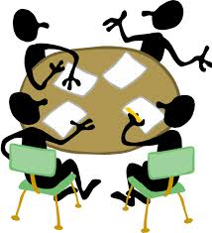
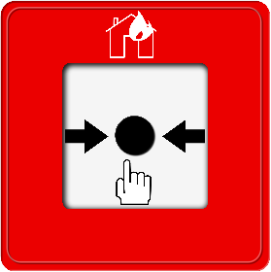
Segregation of duties (3/3) Separate roles, not individuals!
On-call duty this week
administrative system privileges on demand
break-glass-procedure to activate
On-call duty next week
Disseminate roles to all team members
Notes:
The most fundamental change is to accept the separation of the roles of dev and ops, while allowing every team member to fill out all roles when needed.
So while formally accepting that the roles of dev and ops are separate, we take the freedom to define who is needed in the ops role at any given point in time.
Technically, this means the qualified employees have an inactive admin account.
And as everyone can call the firefighters in case of fire, the employees on call can use a break-glass-procedure to activate it when needed.

Slide 22
Code Review (1/2) Does PCI DSS* allow continuous deployment?
PCI DSS
Requirement 6.3.2
---
Review custom code prior to release to production or customers in order to identify any potential coding vulnerability
DevOps helps with a fully automated tool chain
Add vulnerability scanner to your build process
Guidance
---
Automated tools or processes may also be used in lieu of manual reviews,
*PCI DSS: Payment Card Industry Data Security Standard
Notes:
Now we come to a more sophisticated restriction.
For those of you who do not know, PCI is an organization representing the payment card industry like VISA and Mastercard and its objective is to prevent misuse of the card payment ecosystem.
The requirement I have chosen is about code review, meaning that you cannot deploy software without prior review by second engineer.
Here again, DevOps helps to improve the situation if the tool chain is automated.
Today, there is a market of products that are able to detect security vulnerabilities to a certain degree. So, everything is fine?

Slide 23
Requirement Example: PCI DSS Req. 6.3.2: Code Review (2/2)
Guidance
---
Automated tools or processes may also be used in lieu of manual reviews, but keep in mind that it may be difficult or even impossible for an automated tool to identify some coding issues
mark critical features
define process with opt-in clause for reviews
build
marked as critical ?
Y
review code
N
deploy
Notes:
Unfortunately not. Because it is difficult for tools to find fraudulent code.
The solution we found for this case is to define an opt-in clause in our application development process.
For changes in critical parts like a booking system, we define that a code review is needed.
Said that, if we do not define a change as critical, we can deploy automatically without prior code review.
Now, of course, this is only accepted as long as we can show evidence that we actually mark changes in critical code as to be reviewed and review the code.

Slide 24
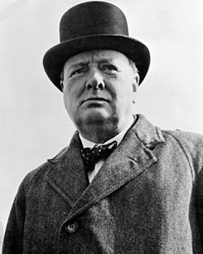
How to survive a DevOps transition in the financial industry?
Involve the compliance officers and auditors early in your plans, work out solutions that work for them too
Track down internal rules, controls, directives to their source, amend them if necessary
Be confident – DevOps works and improves the auditability, quality and security of our systems
Never give up on something that you can't go a day without thinking about.
Winston Churchill

Slide 25
Thank you for your attention!
Here’s the help I’m looking for:
Ways to show the value of software engineering to top management.
You can reach me at: robert.scherrer@six-group.com

